Slide 1
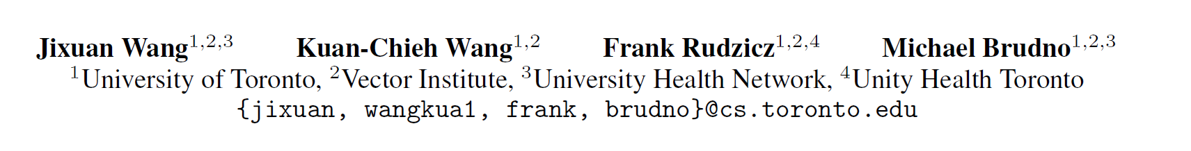
Grad2Task: Improved Few-shot Text Classification
Using Gradients for Task Representation
1

Slide 2
Motivation
A single source task Target task
A set of sources task Target task
Combine ?
Finetune: overfit
Meta learning: different source tasks
2
Notes:
小样本文本分类，然后从其他任务迁移到目标任务上
不同的源任务不仅在输入域方面不同，而且它们的任务结构(即标签语义和输出标签的数量)也不同

Slide 3
Contribution
Use of gradients as features to represent tasks
Pre-trained BERT with adapter modules
> traditional fine-tuning
>state of-the-art meta-learning approaches
3
Notes:
两种方法：支持集S，query集Q
f(Si;Qi)g从D中采样并在目标任务上测试(S;Q)

Slide 4
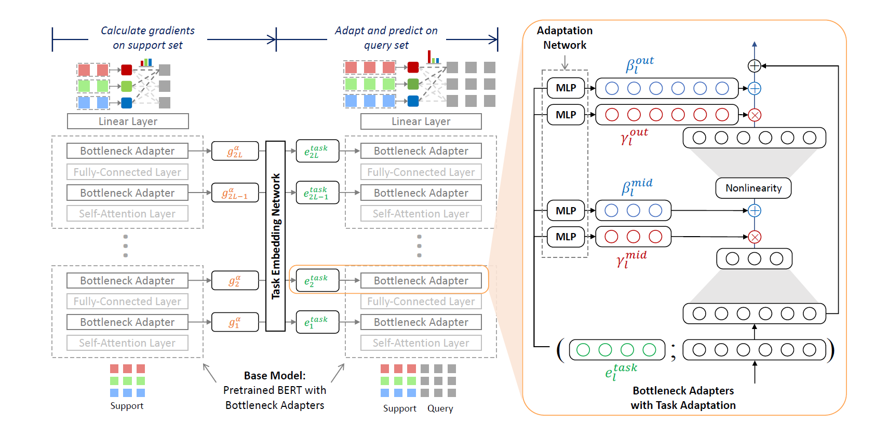
Overview
4
Notes:
两种方法：支持集S，query集Q
f(Si;Qi)g从D中采样并在目标任务上测试(S;Q)

Slide 5
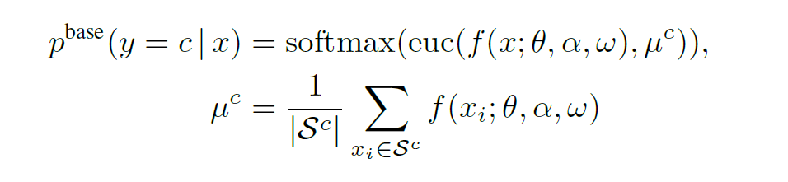
Overview
A base model : f
Use the base model to compute gradients for support set
BERT+adapter
5
Notes:
两个原因：避免过拟合以及训练搞笑
另一个原因就是方便计算梯度，用的是adapter的梯度。

Slide 6
Overview
Task embedding network :d
Map gradients to task representations
RNN
Fisher Information Matrix (FIM)
6
Notes:
两种方法：支持集S，query集Q
f(Si;Qi)g从D中采样并在目标任务上测试(S;Q)

Slide 7
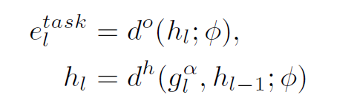
Overview
Task embedding network :d
Map gradients to task representations
RNN
Fisher Information Matrix (FIM)
7
Notes:
两种方法：支持集S，query集Q
f(Si;Qi)g从D中采样并在目标任务上测试(S;Q)

Slide 8
Overview
Adaptation networks: a
Input: task representations + previous adapter output
Output: adaptation parameters
output hidden representation.
scaling adaptation parameters
shifting adaptation parameters
Middle layer
8
Notes:
两种方法：支持集S，query集Q
f(Si;Qi)g从D中采样并在目标任务上测试(S;Q)

Slide 9
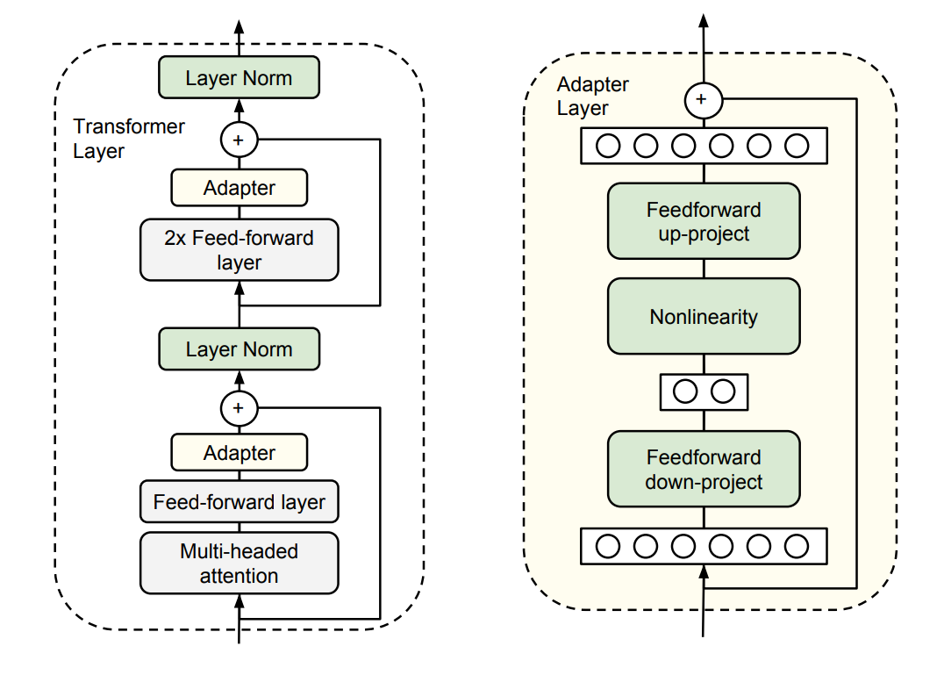
Overview
9

Slide 10
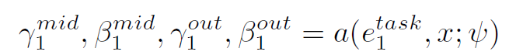
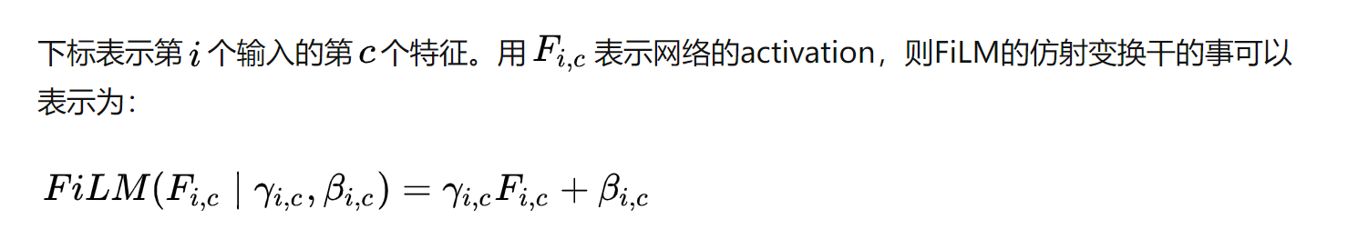
Overview
Adaptation networks: a
Input: task representations + previous adapter output
Output: adaptation parameters for representation(hidden or output)
10
Notes:
两种方法：支持集S，query集Q
f(Si;Qi)g从D中采样并在目标任务上测试(S;Q)

Slide 11
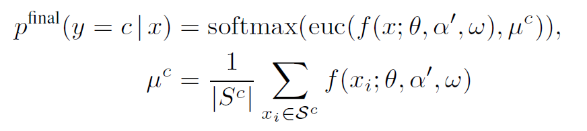
Overview
Adaptation networks: a
Input: task representations + previous adapter output
Output: adaptation parameters for representation(hidden or output)
11

Slide 12
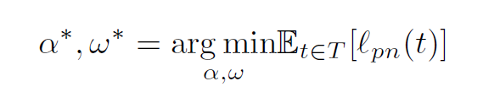
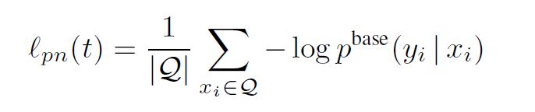
Model training
Train the base model using episodic training
Bottleneck adapters, layer normalization and the top linear layer are updated
12
Notes:
两种方法：支持集S，query集Q
f(Si;Qi)g从D中采样并在目标任务上测试(S;Q)

Slide 13
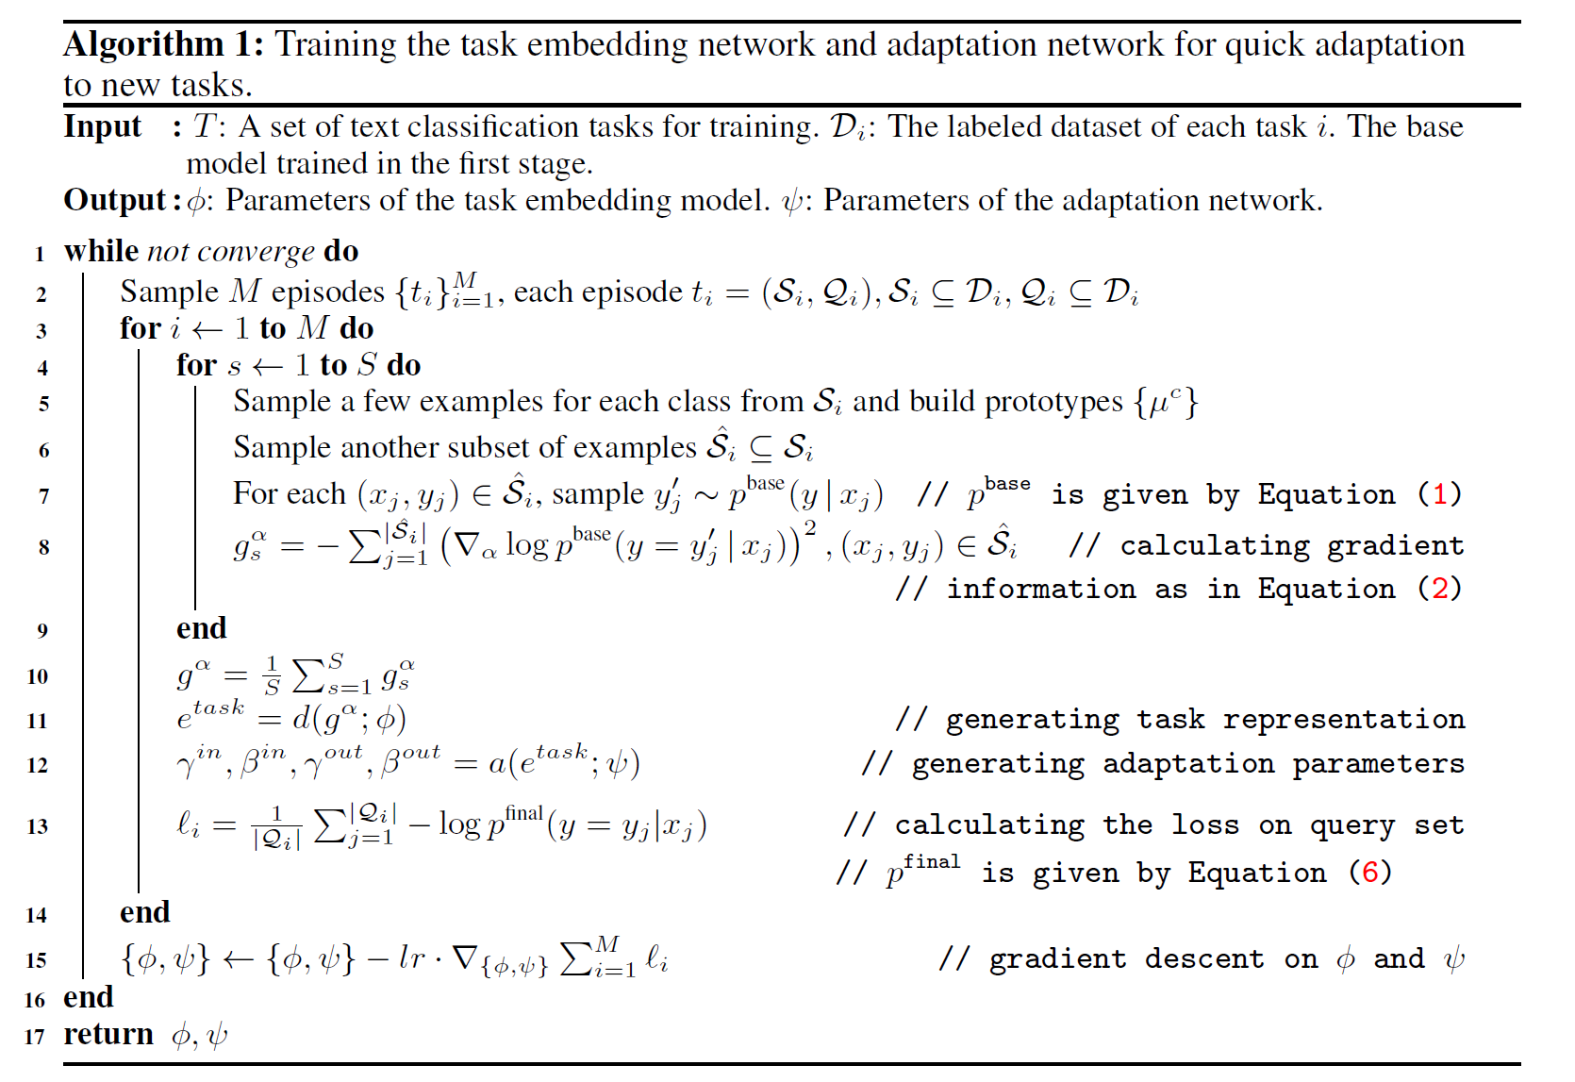
Model training
13
Notes:
两种方法：支持集S，query集Q
f(Si;Qi)g从D中采样并在目标任务上测试(S;Q)

Slide 14
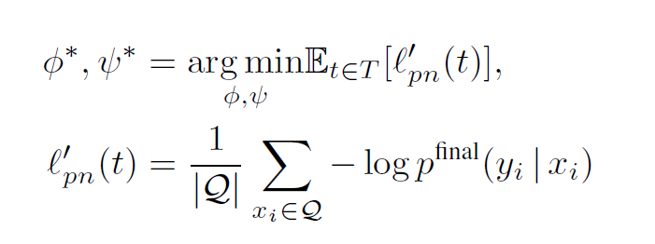
Second stage
Train the base model using episodic training
Bottleneck adapters, layer normalization and the top linear layer are updated
14

Slide 15
Overview
15
Notes:
两种方法：支持集S，query集Q
f(Si;Qi)g从D中采样并在目标任务上测试(S;Q)

Slide 16
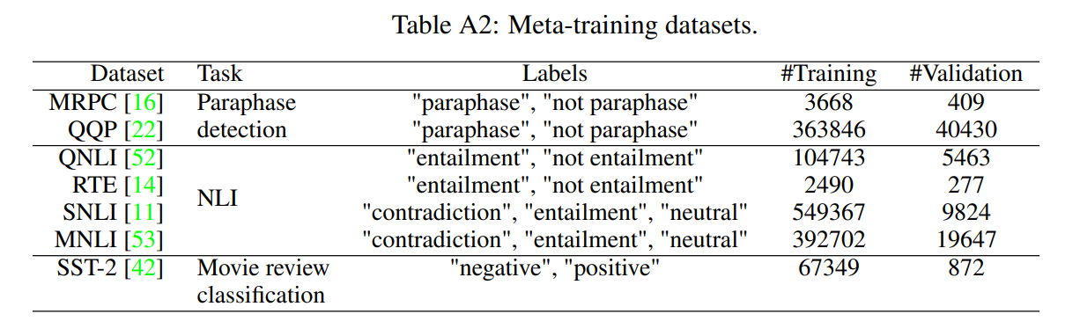
Experiment
GLUE benchmark
16
Notes:
大多数meta-learning的方法不能抵挡攻击

Slide 17
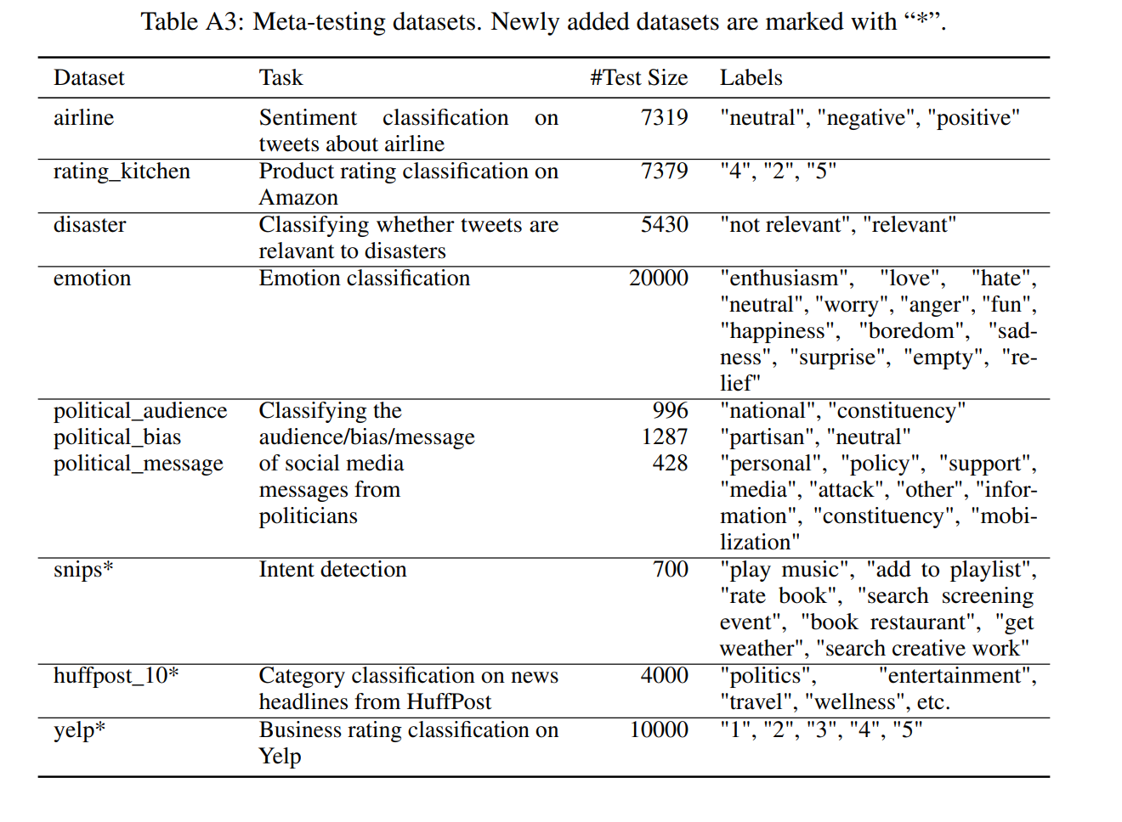
Experiment
17

Slide 18
Baseline
BERT：simply fine-tuned on target task
MT-BERT：multi-task learning (meta-training tasks)+fine tune
ProtoNet-BERT：trained episodically on the meta-training
ProtoNet-BN：ProtoNet-BERT but with adapter
MAML
Grad2Task：pretrained ProtoNet-BN and trained episodically to learn to adapt.
18

Slide 19
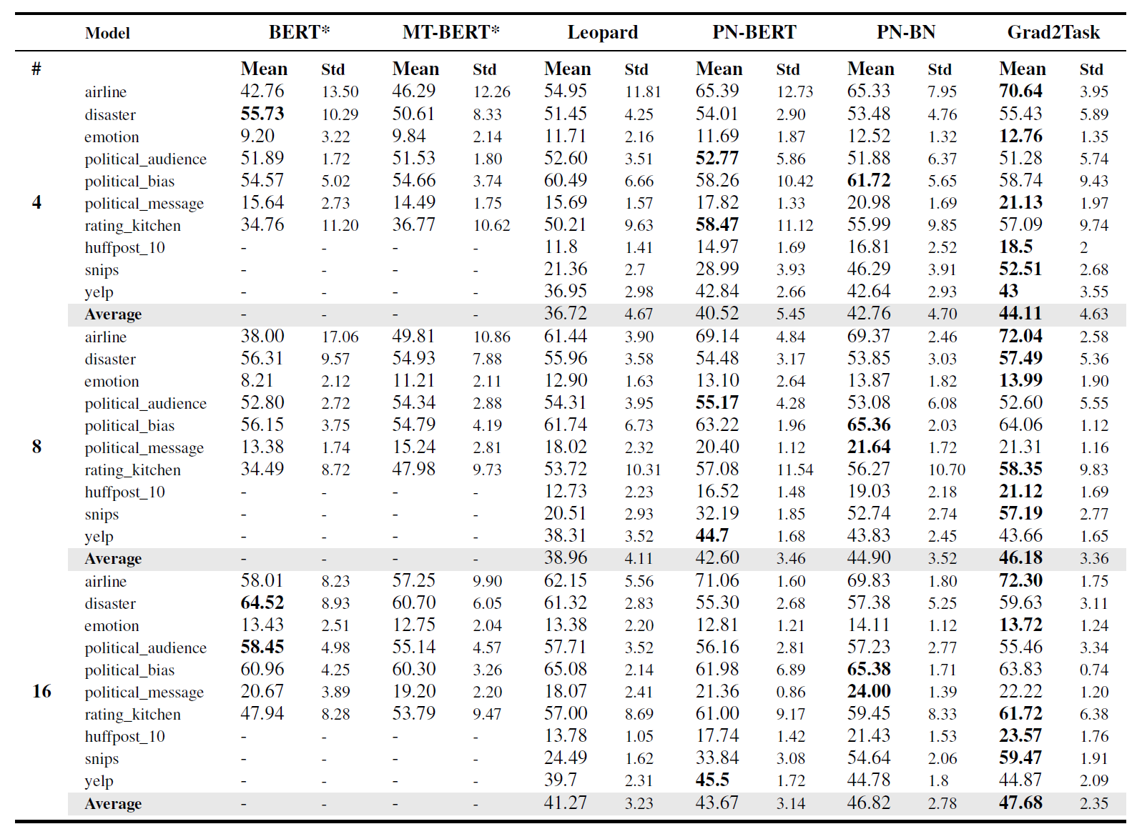
RESULT
19
Notes:
Clean-clean:训练数据是干净的，测试数据是干净的
A-B：A代表训练数据的样式，B代表测试数据的样式

Slide 20
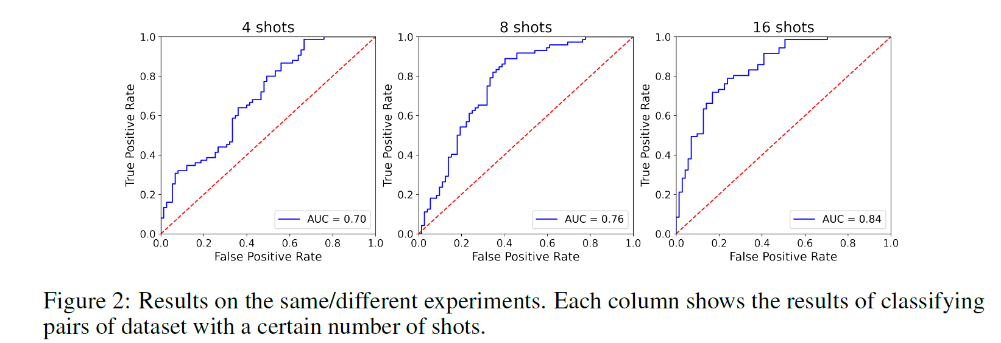
RESULT
20
Notes:
40%-clean:每个类40%的样本是对抗性的，剩下60%是干净的

Slide 21
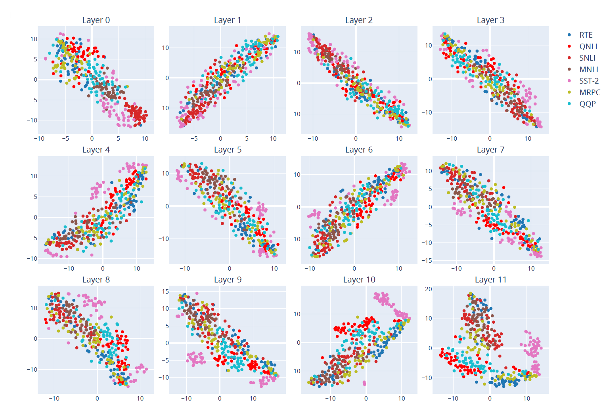
Task embedding
21
Notes:
40%-clean:每个类40%的样本是对抗性的，剩下60%是干净的

Slide 22
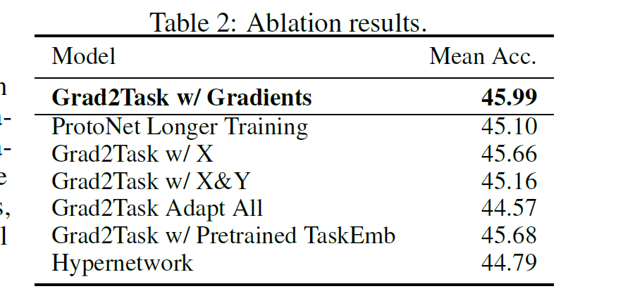
RESULT
Grad2Task w/x: average embeddings for task representation
Grad2Task Adapt All:not only for cls
Pretraining task embedding?
Generating model parameters vs adaptation parameters
22
Notes:
我们的模型在几次梯度更新后急剧下降，并在元测试期间稳定在小值（更新较快？

Slide 23
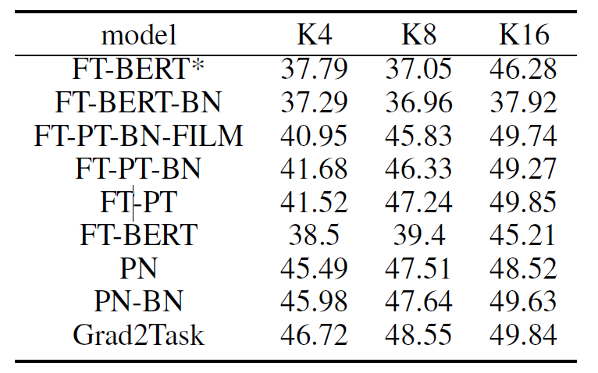
RESULT
FT: fine-tune
BN: bottleneck adapters
PN: ProtoNet
23
Notes:
我们的模型在几次梯度更新后急剧下降，并在元测试期间稳定在小值（更新较快？

Slide 24
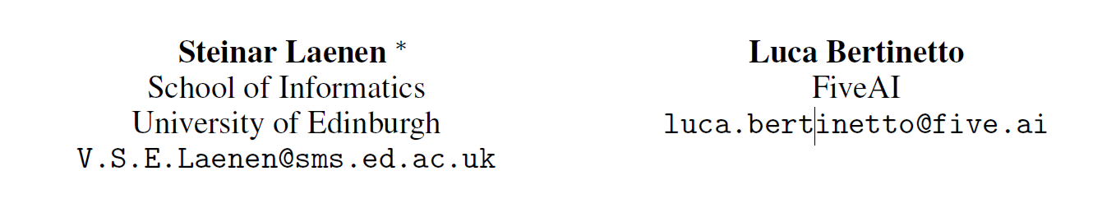
On Episodes, Prototypical Networks,
and Few-Shot Learning
24

Slide 25
Motivation
Simple baselines can outperform established FSL meta-learning methods
Doubt the importance of episodes in FSL?
Matching and Prototypical Networks vs NCA
Important for the community
Ease of experimental design.
25

Slide 26
Findings
Detrimental for performance
Analogous to randomly discarding examples from a batch
introduces a set of superfluous hyperparameters that require careful tuning
26

Slide 27
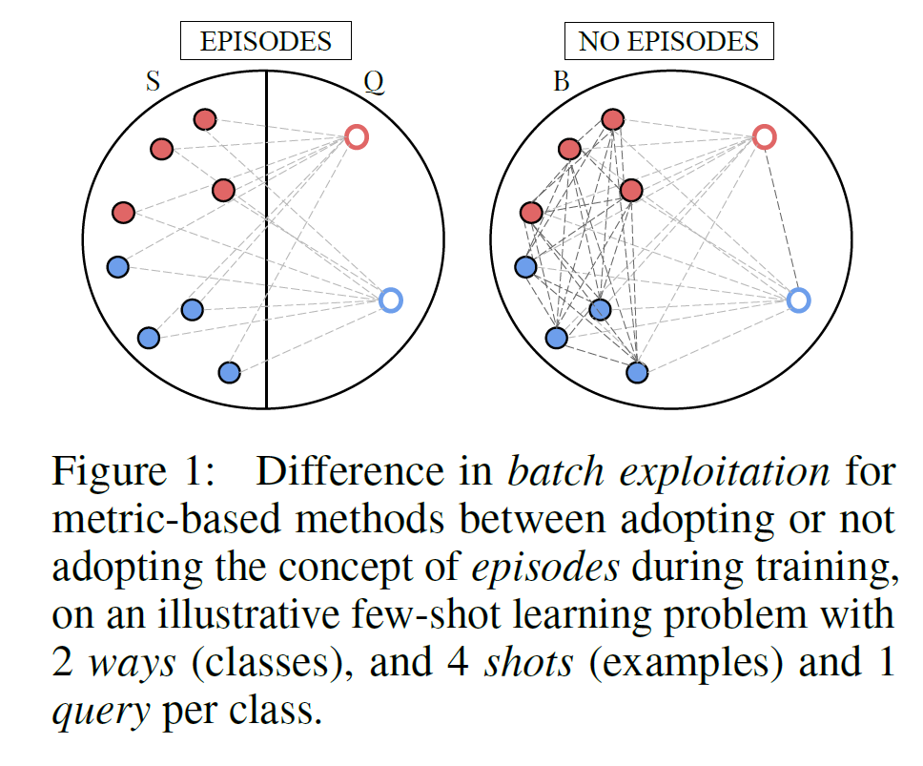
Episodic learning
N way K shot Q query
27

Slide 28
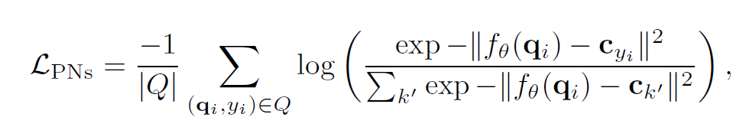
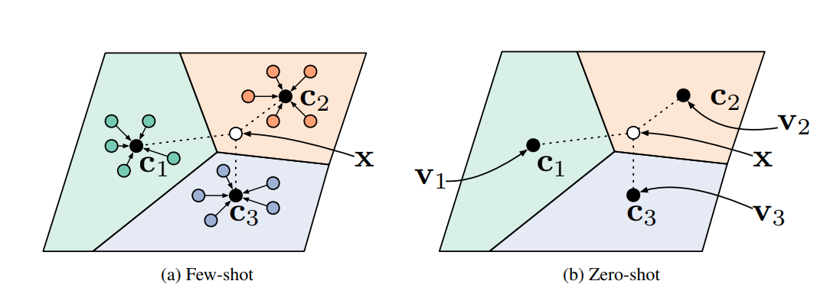
Prototypical networks
28

Slide 29
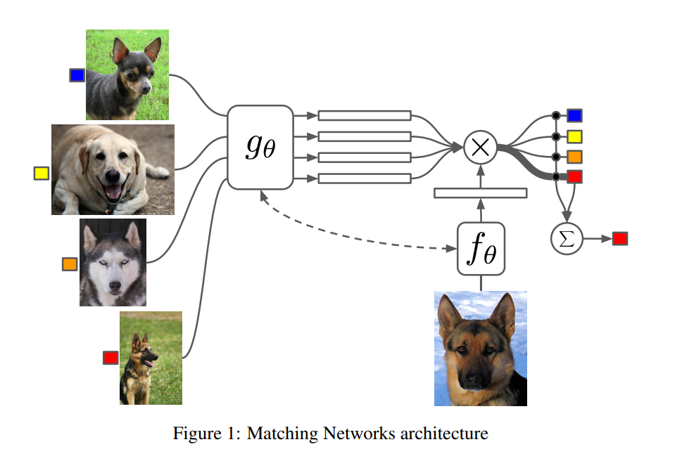
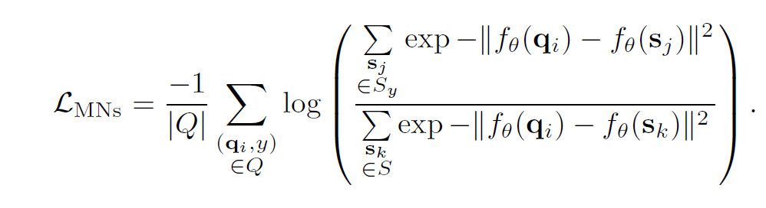
Matching Networks
29

Slide 30
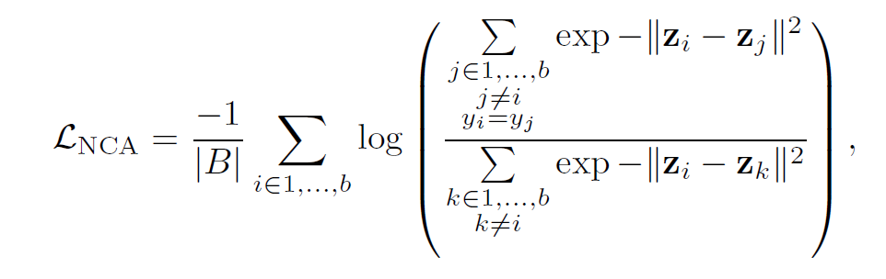
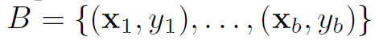
NCA
z: image embedding
30

Slide 31
Differ
P&M: distances between the query and the support set, NCA: all
Only PNs rely on the creation of prototypes
Sampling “with replacement” vs sampling “without replacement”
31

Slide 32
NCA:Evaluation methods
k-NN:
Nearest centroid
Soft assignments.
32

Slide 33
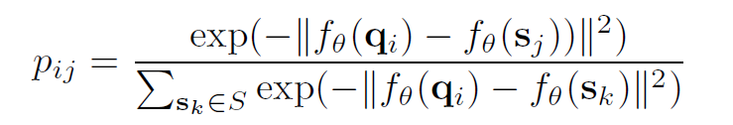
NCA:Evaluation methods
k-NN:
Nearest centroid
Soft assignments.
33

Slide 34
Evaluation methods
k-NN:
Nearest centroid
Soft assignments.
34

Slide 35
Experiment
Dataset: miniImageNet , CIFAR-FS and tieredImageNet
Network: ResNet-12
Batch_size: b vs Episode: w way n shot m query
b = w*(n+m)
35

Slide 36
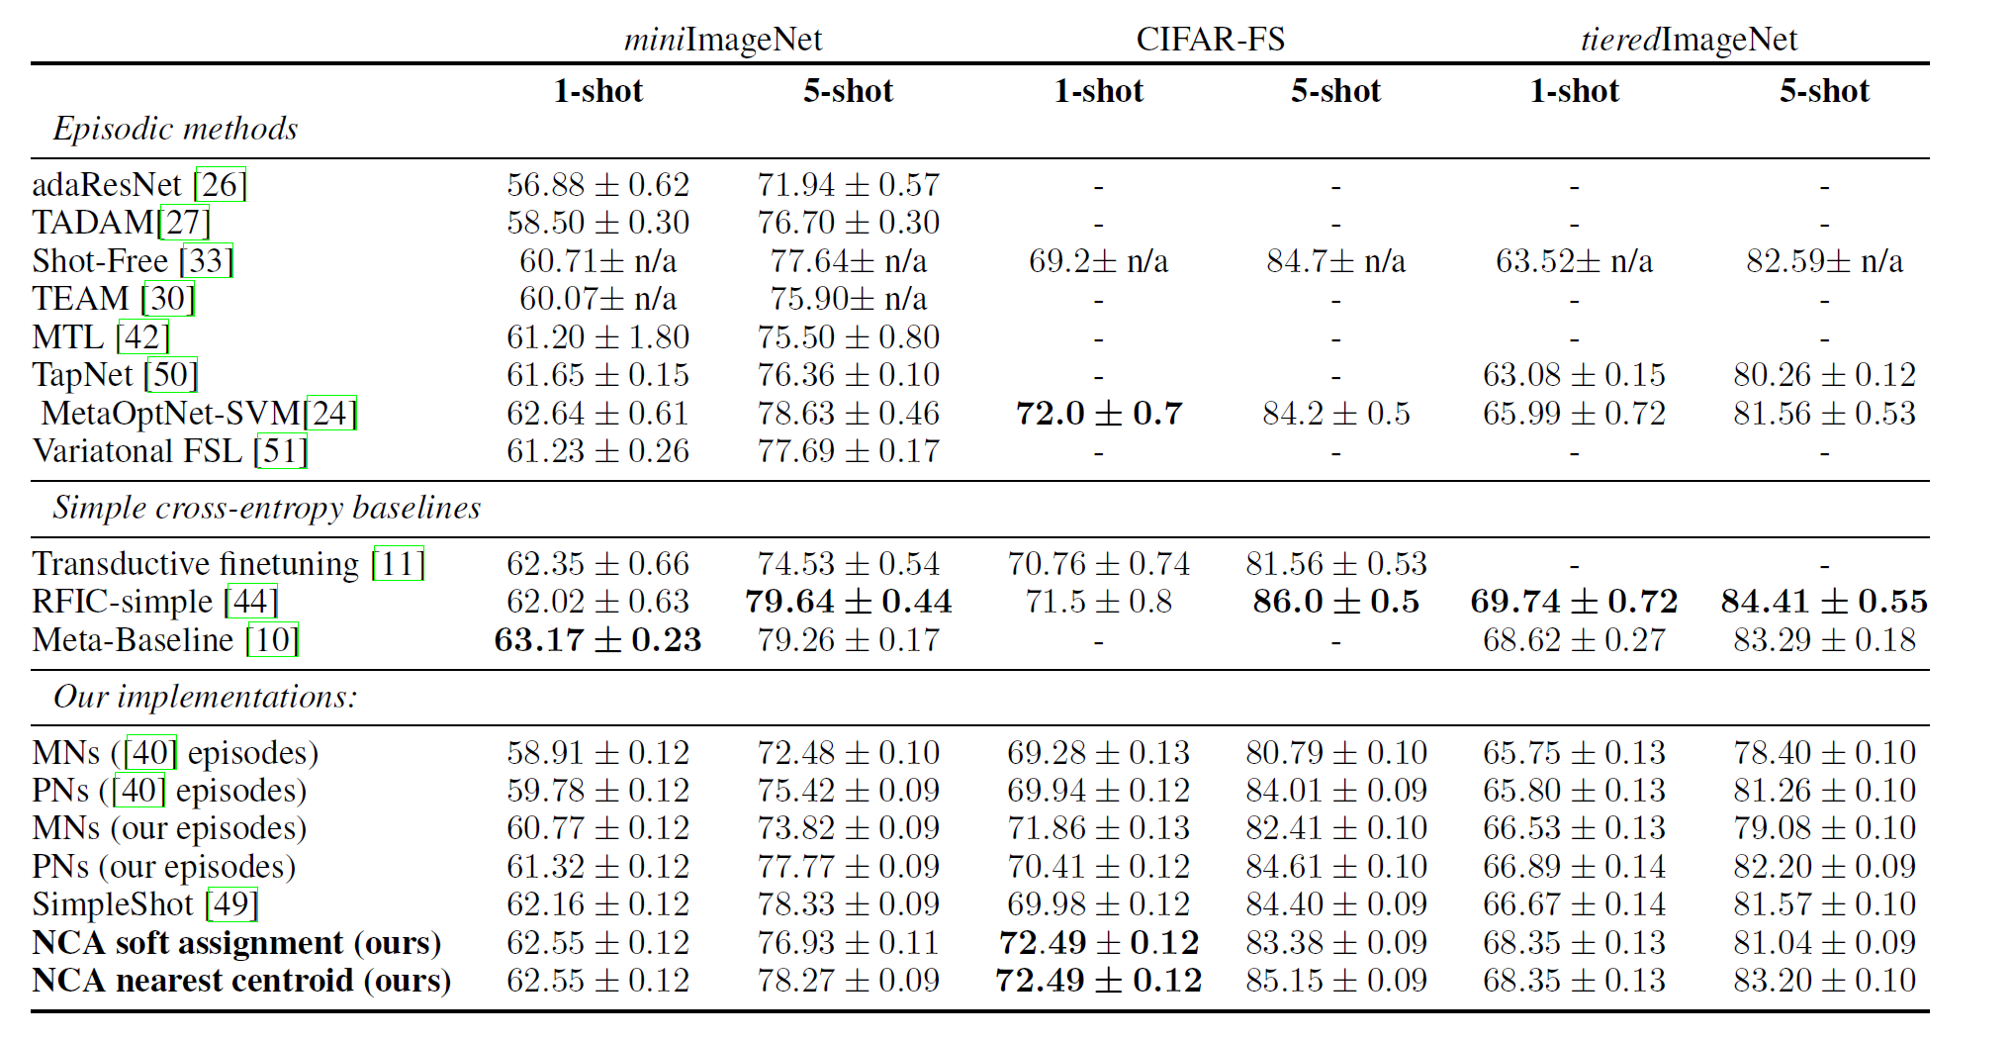
Result
36

Slide 37
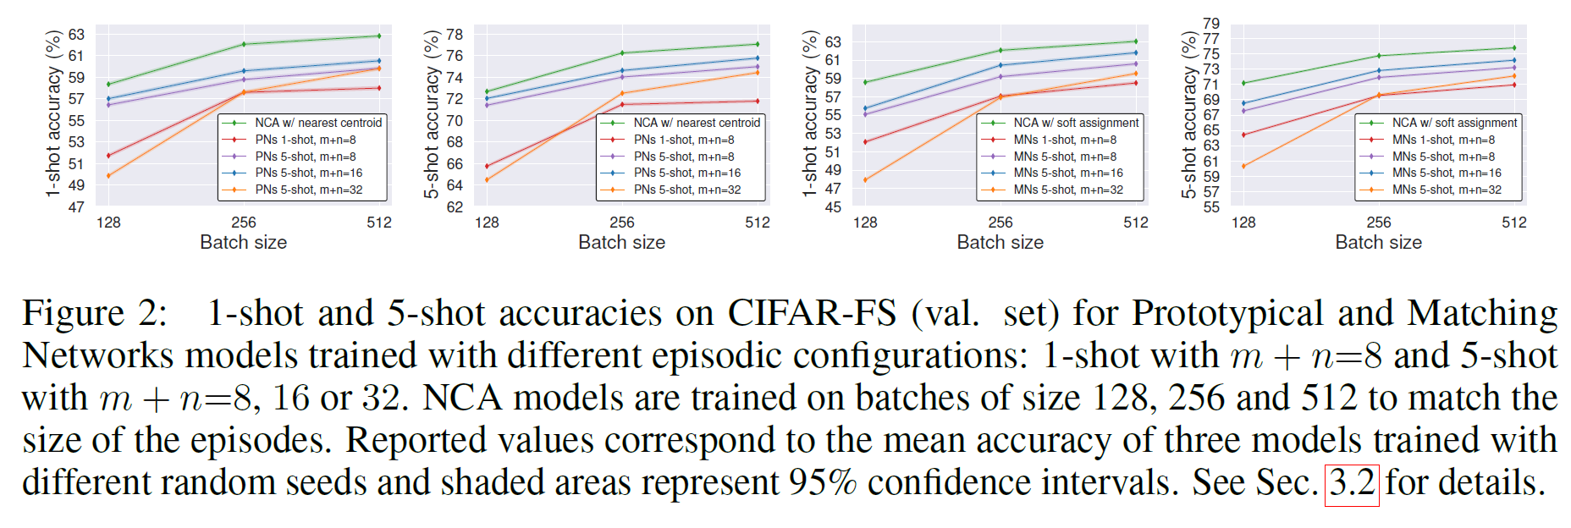
Batch size and episodes
37

Slide 38
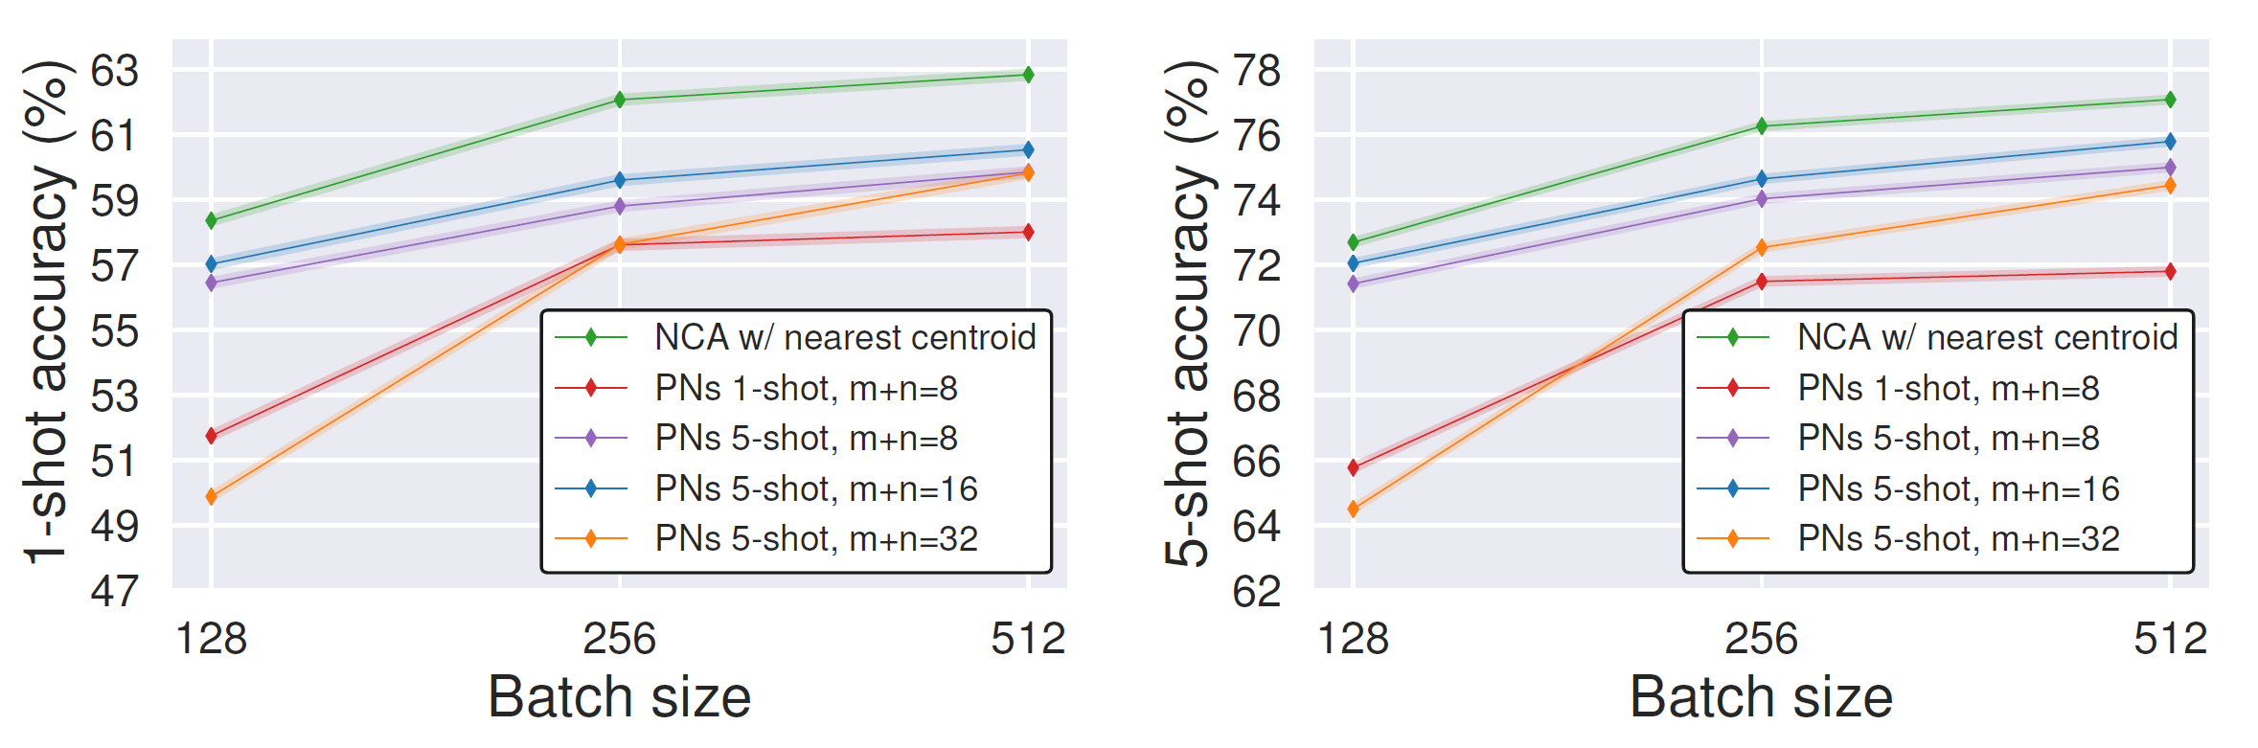
Batch size and episodes
Prototype vs nearest centroid
38

Slide 39
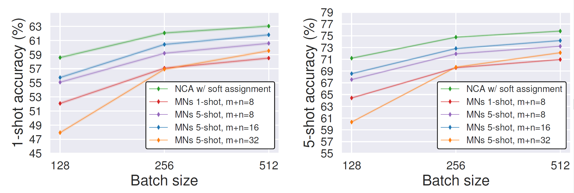
Batch size and episodes
Matching net work vs soft assignment
39

Slide 40
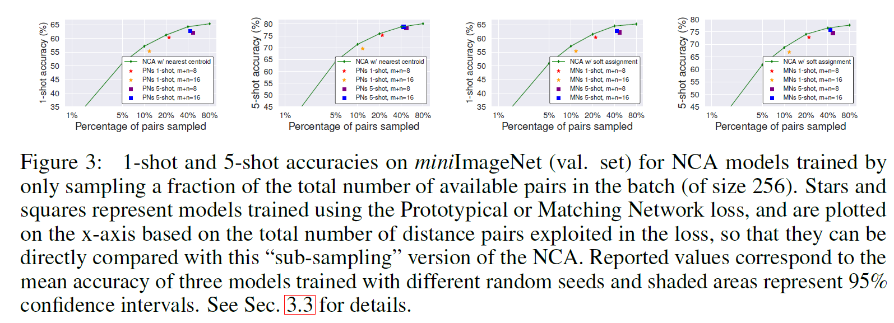
Episodic batches vs. random sub-sampling
Train NCA models by randomly discarding a fraction of the total number of distances
40

Slide 41
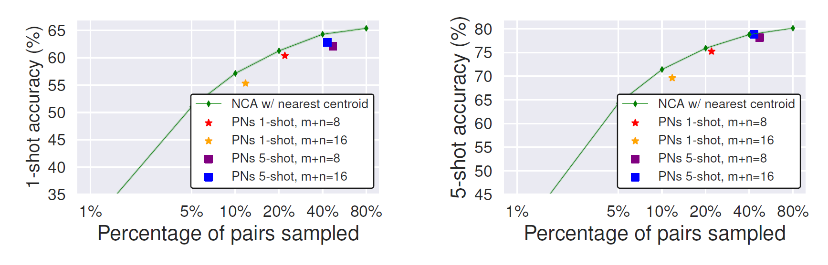
Episodic batches vs. random sub-sampling
41

Slide 42
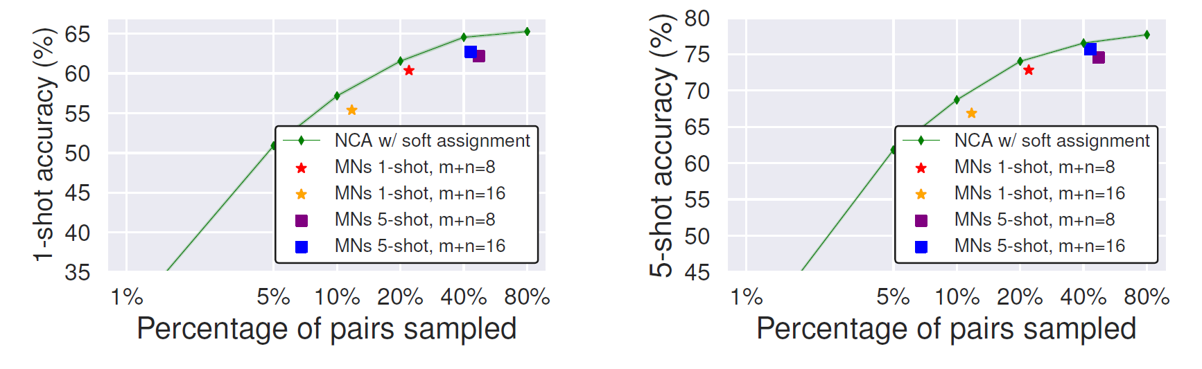
Episodic batches vs. random sub-sampling
42

Slide 43
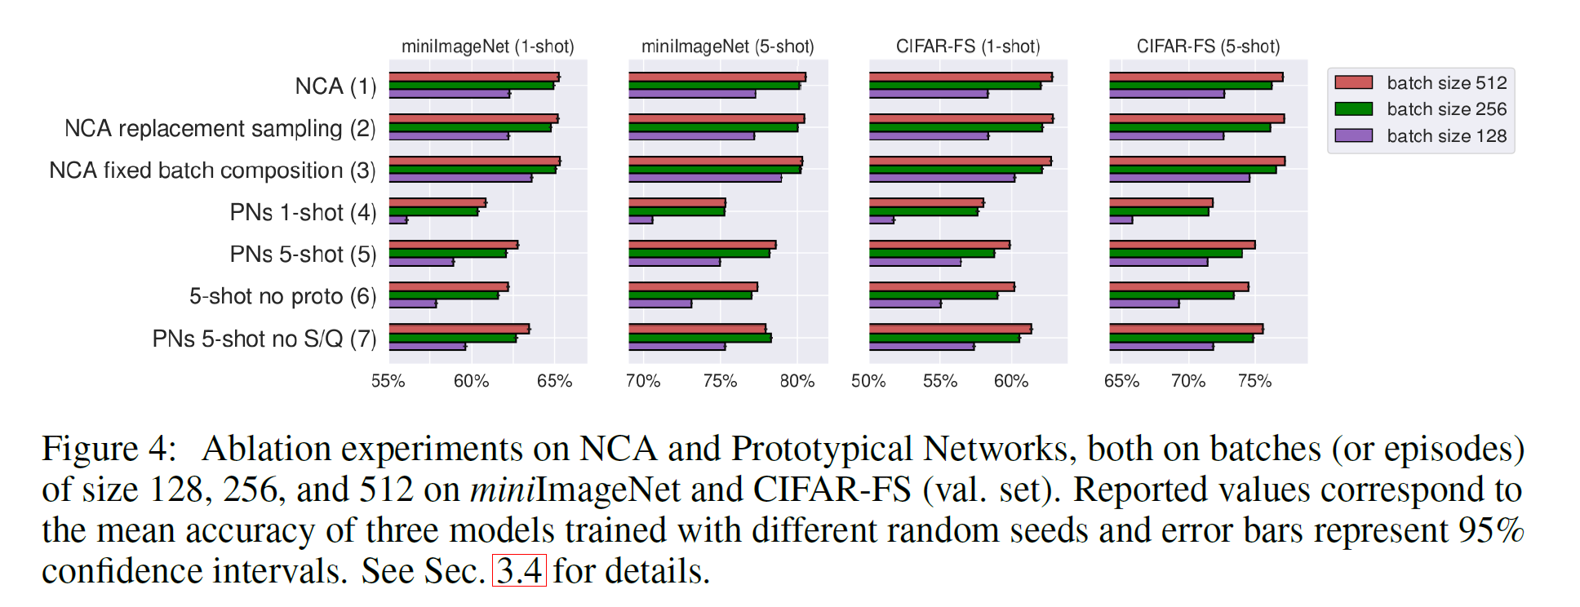
Ablation experiments
Replacement sample?
43

Slide 44
Ablation experiments
Ablations on episodic batches
44

Slide 45
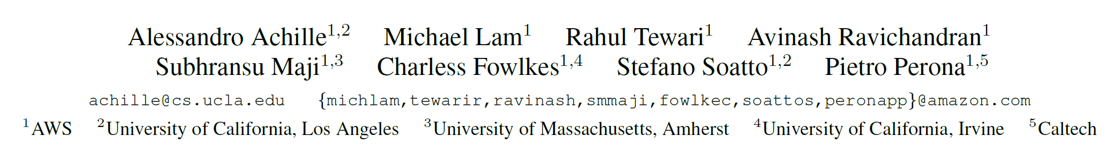
TASK2VEC: Task Embedding for Meta-Learning
45

Slide 46
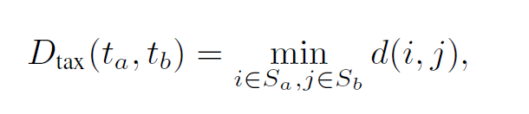
Distance
Domain distance
Taxonomic distance
Transfer distance
46

Slide 47
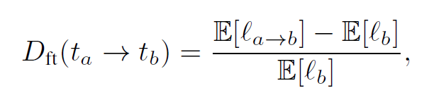
Distance
Domain distance
Taxonomic distance
Transfer distance
47

Slide 48
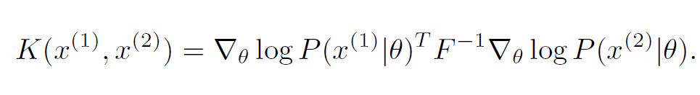
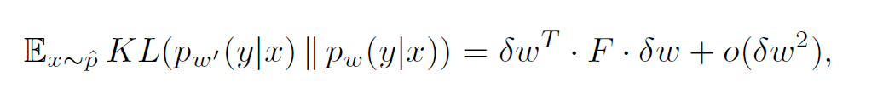
Distance
Domain distance
Taxonomic distance
Transfer distance
Fisher Kernels and Fisher Information
48

Slide 49
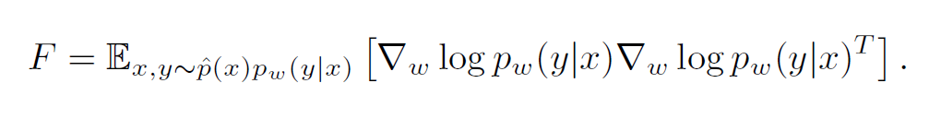
Fisher information matrix
Measure of the information a particular parameter (weight or feature)
Related to the complexity of a task
FIM can be interpreted as an easy-to-compute positive semidefinite upper-bound to the Hessian of the cross-entropy loss and coincides with it at local minima
49

Slide 50
Probe network
Different networks are not directly comparable
“Probe”network：pre-trained on ImageNet and re-train only the classifier layer on any given task
Two additional approximations：
Consider the diagonal entries
Average the Fisher Information for all weights in the same filter
50

